Slide 1
Welcome to Mrs. Brown’s class!!!
Open House 20-21

Slide 2
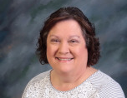
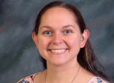
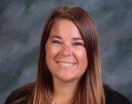
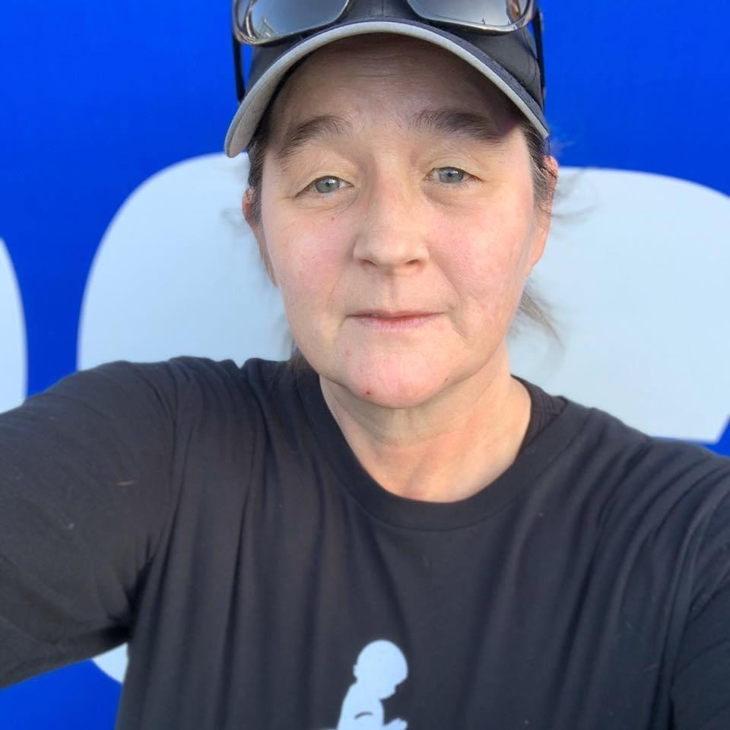
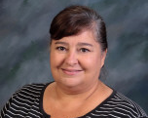
Meet the teachers!
Mrs. Duncan
Mrs. Brown
Mrs. Arivett
Ms. Lyden
Ms. Mechelle

Slide 3
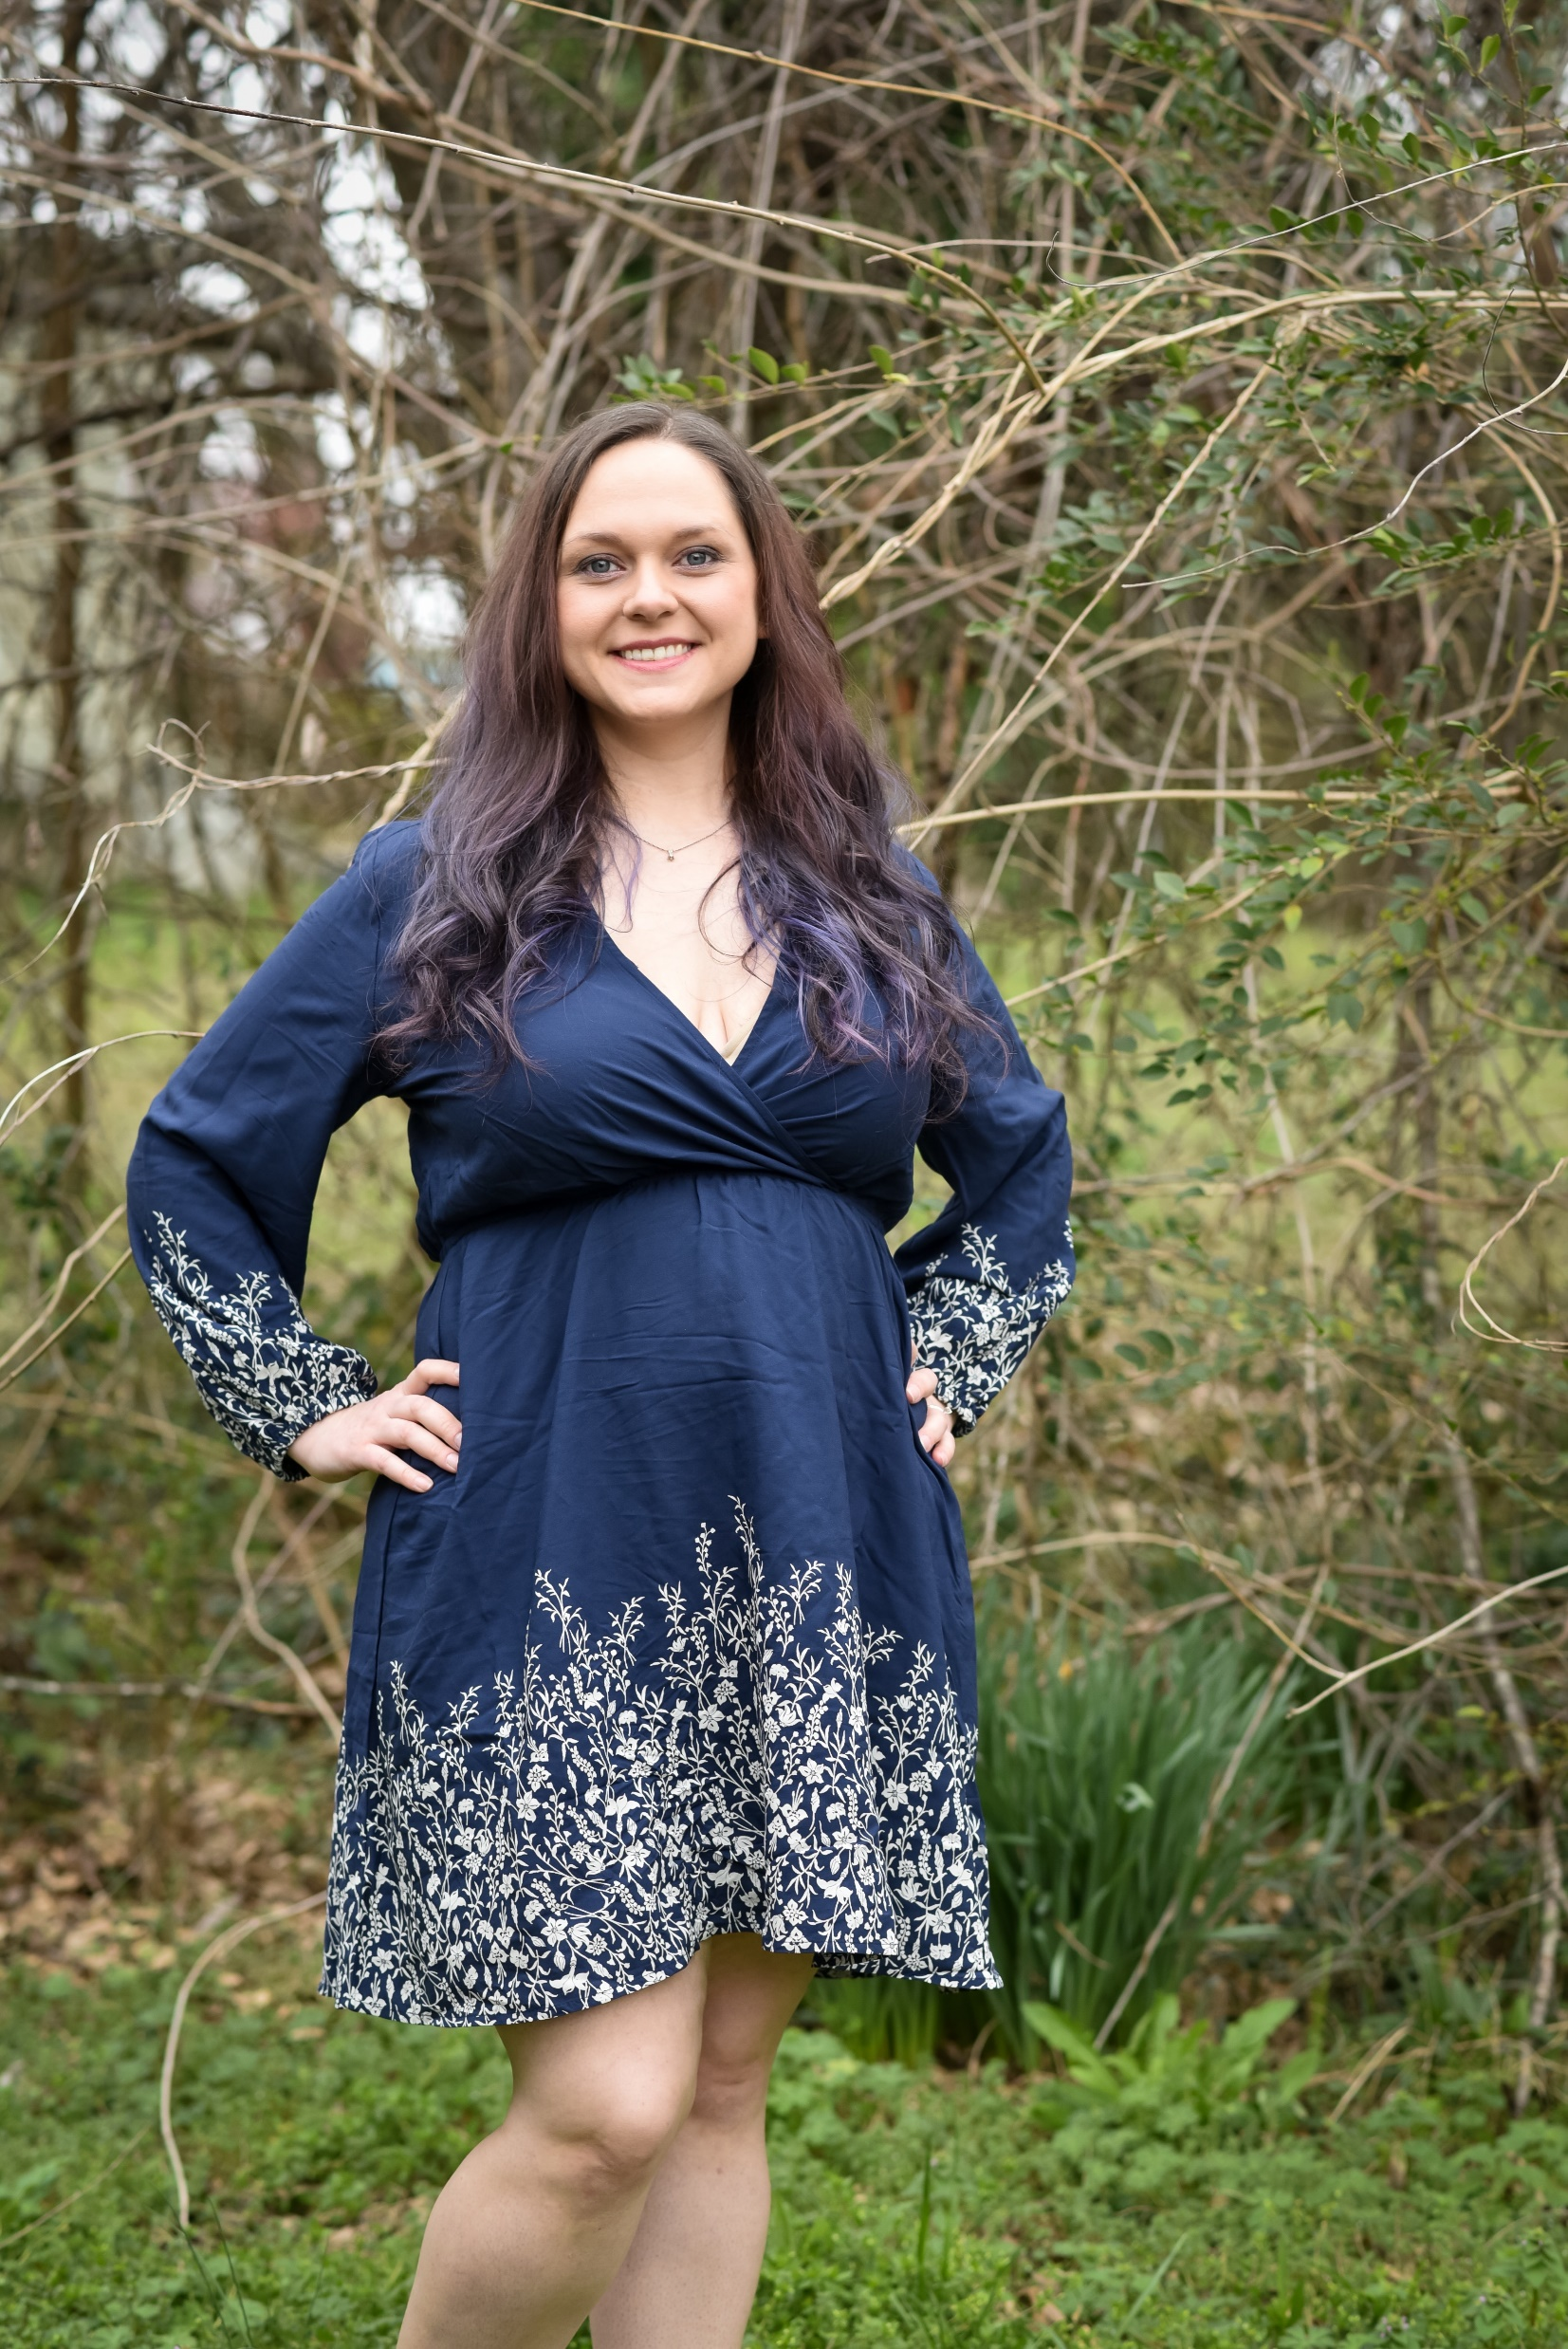
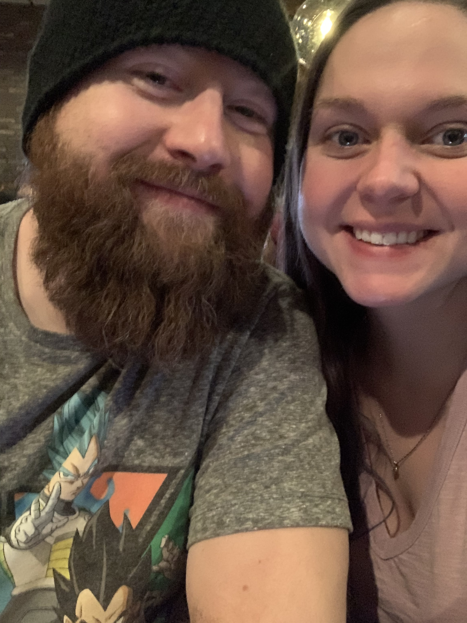
Mrs. Brown
I’m married and I have 2 kids (7 and 3). I have a lot of pets. I love animals, especially penguins. This is my 10th year teaching. I have taught in this position at Scoggins for all 10 years.

Slide 4
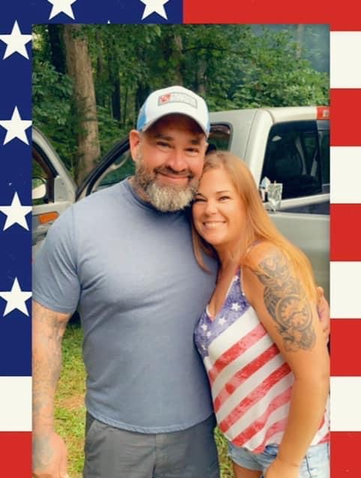
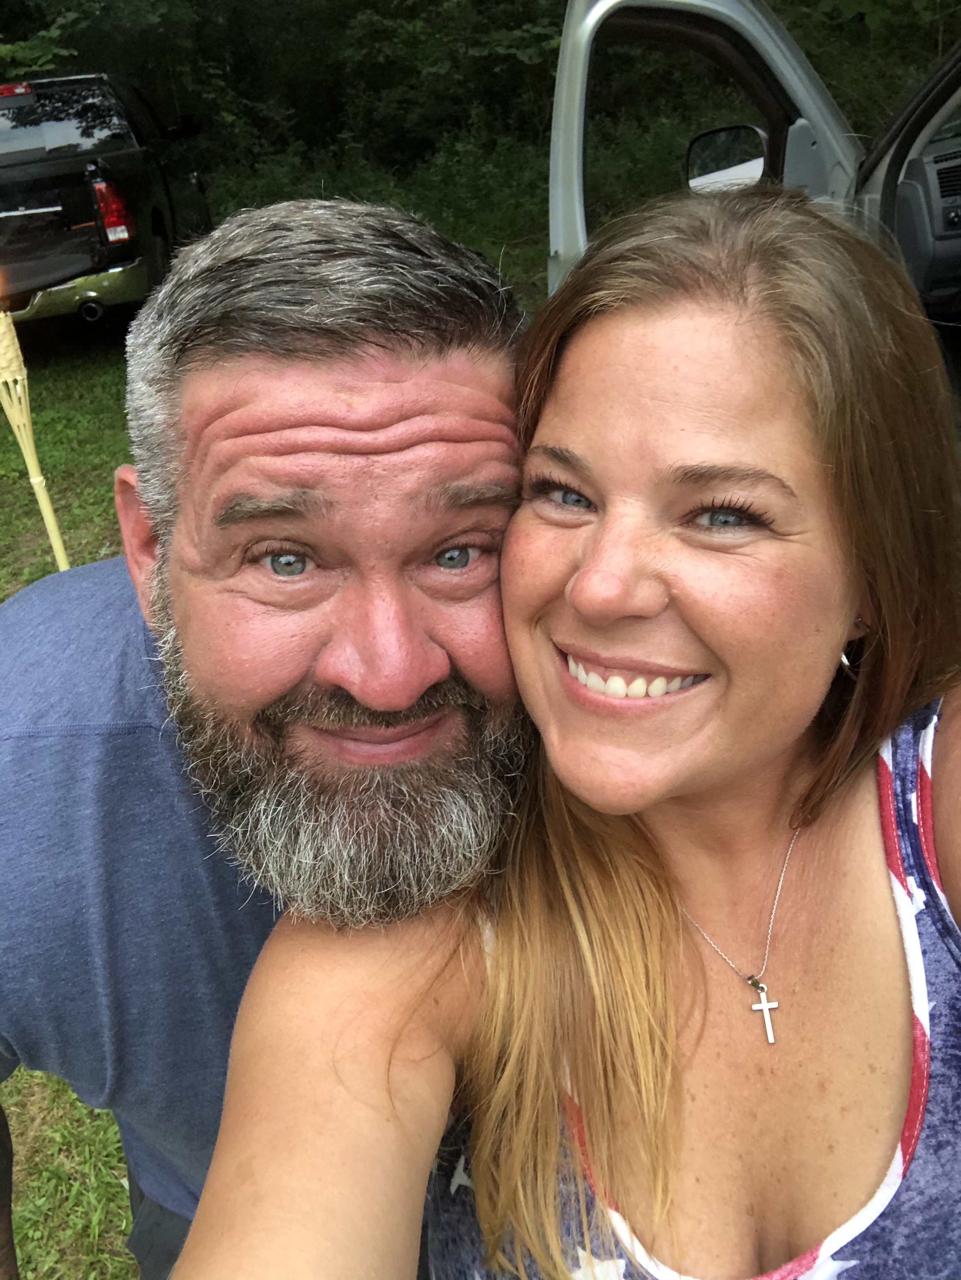
Mrs. Arivett (pronounced R-vett)
I’m married and I have 2 boys (20 and 17). I have been a paraprofessional for 11 years, at Scoggins with Mrs. Brown for 10 years. We have a dog named Stella Rae. We like car shows, refinishing furniture, and antiquing.

Slide 5
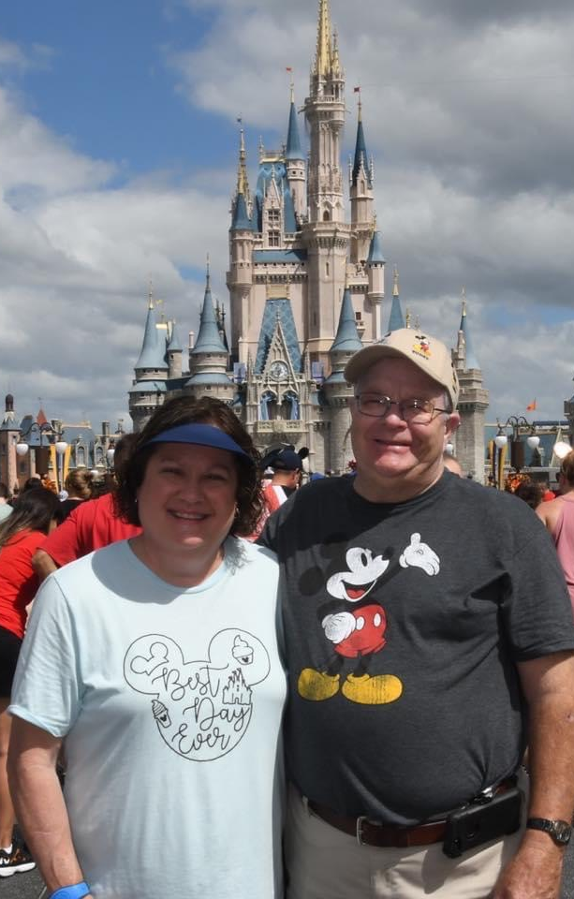
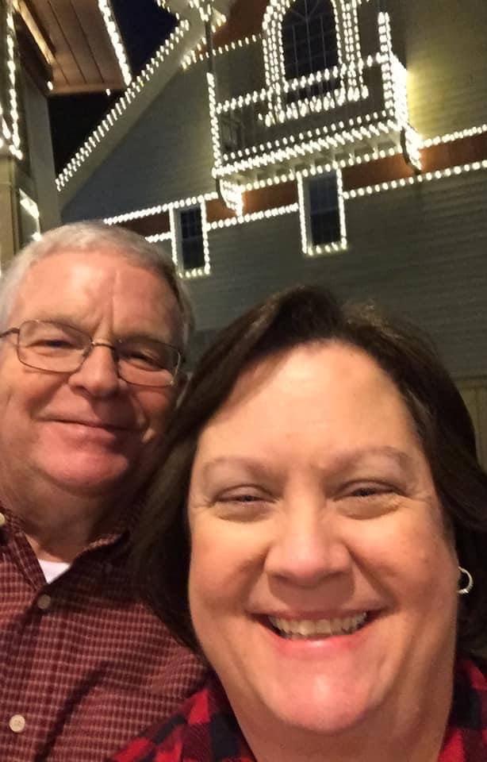
Mrs. Duncan
I’m married and I have 2 children and 3 grandchildren. This is my 20th year as a paraprofessional. I enjoy spending time with my family, especially spending time with my grandchildren.

Slide 6
Ms. Mechelle
I’m married and I have 3 kids and 3 grandchildren. I have been working as a paraprofessional for 24 years.

Slide 7
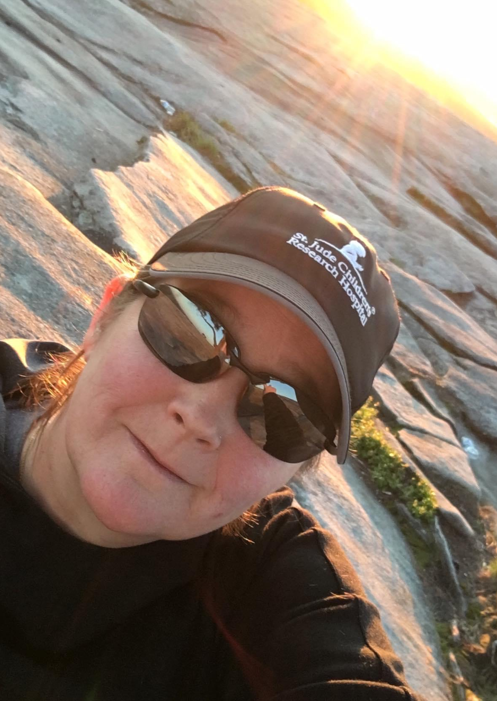
Ms. Lyden
I have a dog. I love Hawaii. I have been teaching for 18 years.

Slide 8
Packets
Please be sure to fill out all forms that have been sent home and return them as soon as possible.

Slide 9
Communication
Daily communication logs will go home with your students to let you know a bit about their day. Please remember to sign the communication sheet and return it each day. We will collect these each Monday. We also have class Dojo. Please look in this packet to find the code to join our class.

Slide 10
Classroom expectations
We use Dojo points in class. Students can earn points and lose points. If your student has 10 Dojo points by the end of the week, they get to participate in Fun Friday (cooking activity and a movie during lunch). Students gain points by setting good examples for peers, participating, and doing fantastic jobs on their work. Students lose points by breaking one of our class rules. These will be reviewed with the students in class.

Slide 11
First week Schedule
The first week of school is split with in person instruction and Digital Learning. August 3rd- 5th will be in person. August 6th and 7th will be digital.

Slide 12
Digital Learning
Please look for login information for n2y.com and Canvas coming home soon.
Also, please make sure that you make accommodations for Digital Learning this year. It is important for the continuation of your student’s progress and learning that they be able to participate online. Please contact the school if you have any questions or needs.

Slide 13
Supplies
We ask that you provide the following for your student:
1 inch binder
3 ring pencil pouch with zipper
Marker or color pencils
Optional supplies:
Baby wipes
Construction paper
Notebook Paper
Tissues
Cap erasers
Gallon sized ziplock bags
Sandwich sized ziplock bags

Slide 14
Other info
Lunch/Snack
Your students may bring or buy a lunch. The school is encouraging parents to use MySchoolBucks to put money on students’ lunch accounts. Look for a flyer for how to use MySchoolBucks. If your student brings a lunch, they may keep it in the refrigerator in our kitchen. They may also bring food to microwave.
We have snack each afternoon. You may send in snack each day or send in enough snack for an extended amount of time and we can store it in the kitchen. Please write your student’s name on snack you send in for us to keep. Also, the county is encouraging that students bring water bottles for students to use and refill throughout the day. Please fill free to send a water bottle with your student.
Change of Clothes
If you would like to, you may send in a change of clothes for your student to keep at school in case of accidents or spills.

Slide 15
Contact info
Please contact me anytime by calling the school, emailing me at lgbrown@paulding.k12.ga.us, or through Class Dojo. We look forward to a wonderful year with all of you!

